Slide 1
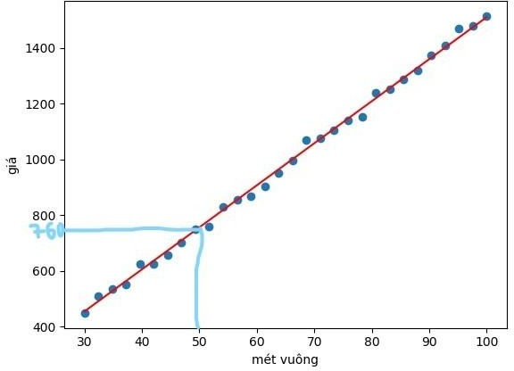
Linear regression

Slide 2
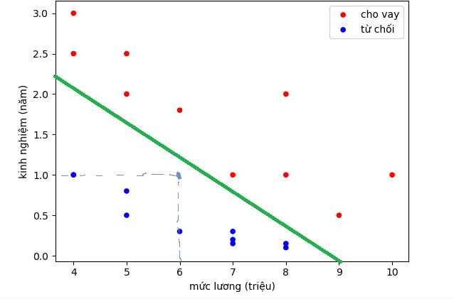
Logistic regression

Slide 3
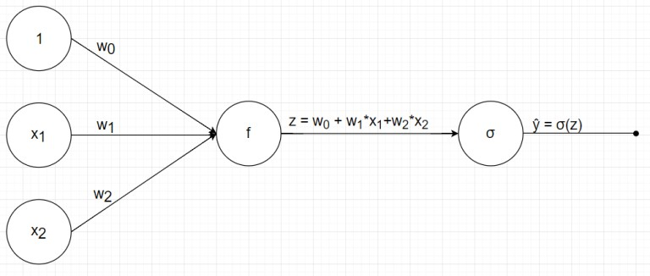
Logistic regression

Slide 4
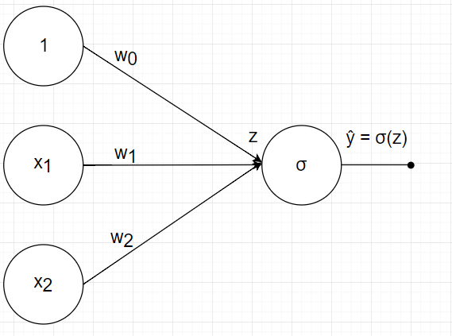
Logistic regression

Slide 5
How?
Define the problem
Visualize the data
Choose the model
Define loss function
Minimize loss function
Use the model to predict new data.

Slide 6
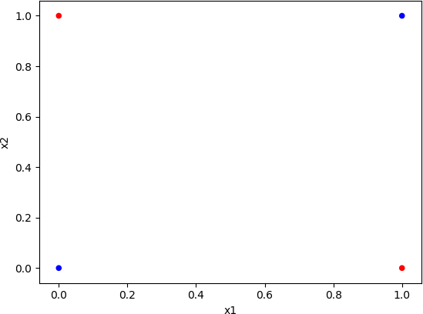
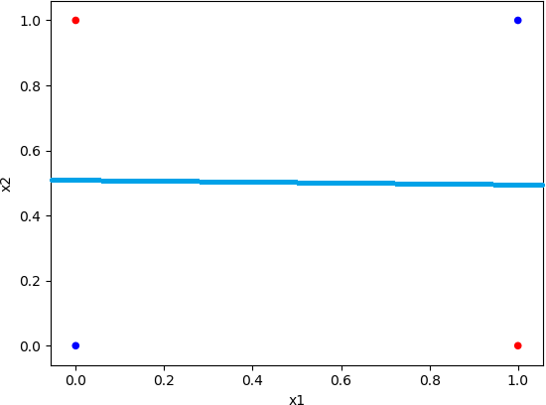
XOR problem

Slide 7
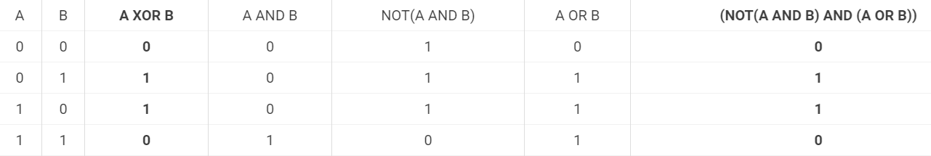
How to solve XOR problem
A XOR B = (NOT(A AND B) AND (A OR B))

Slide 8
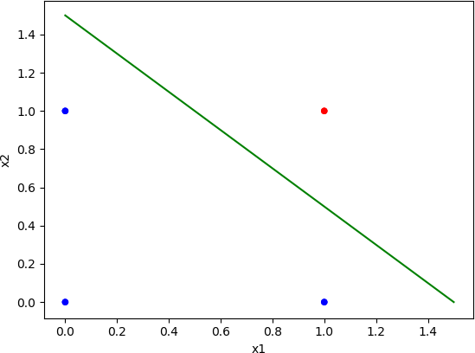
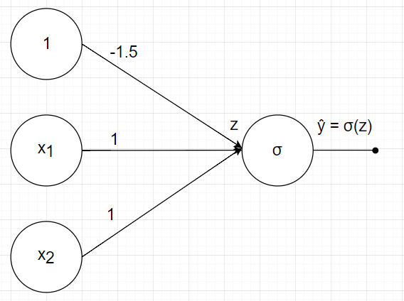
AND

Slide 9
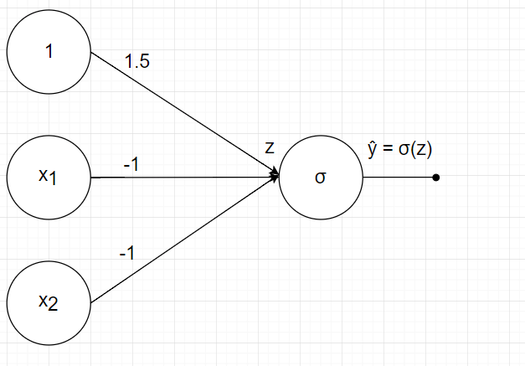
NOT AND
AND
NOT AND

Slide 10
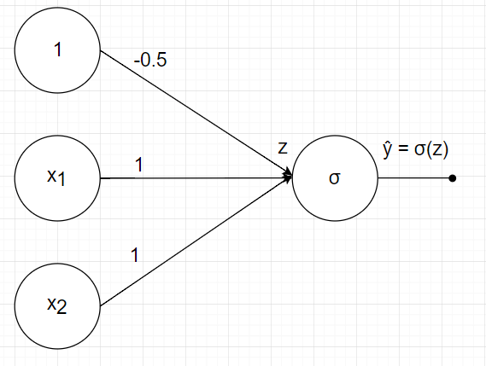
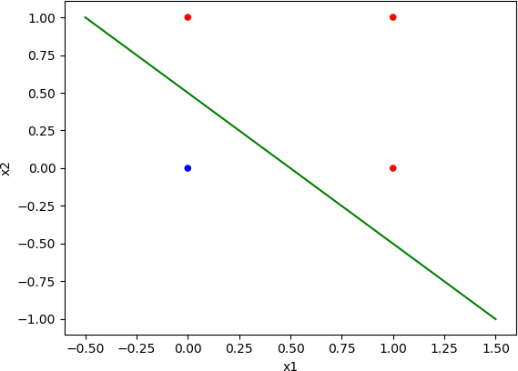
OR

Slide 11
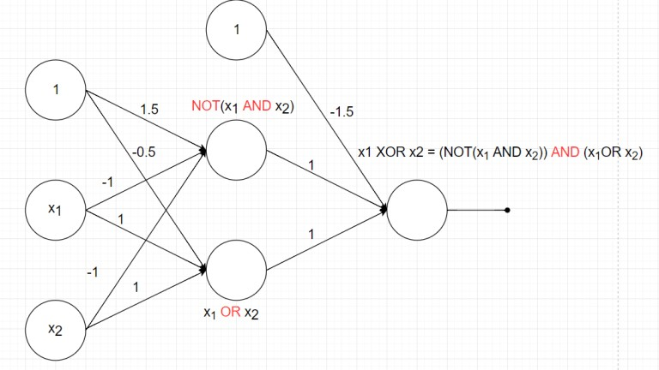
XOR
A XOR B = (NOT(A AND B) AND (A OR B))

Slide 12
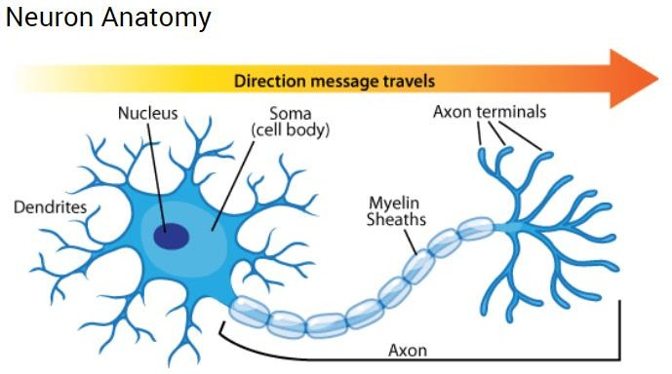
Neural network inspiration

Slide 13
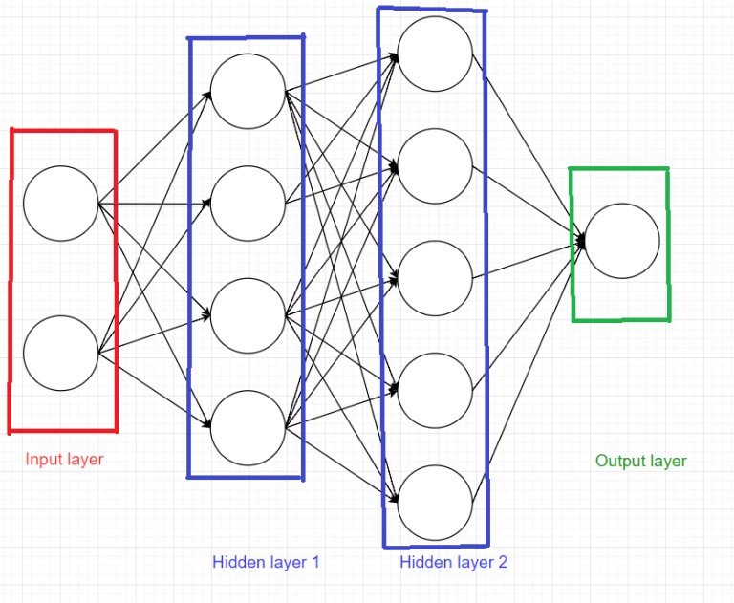
Neural network

Slide 14
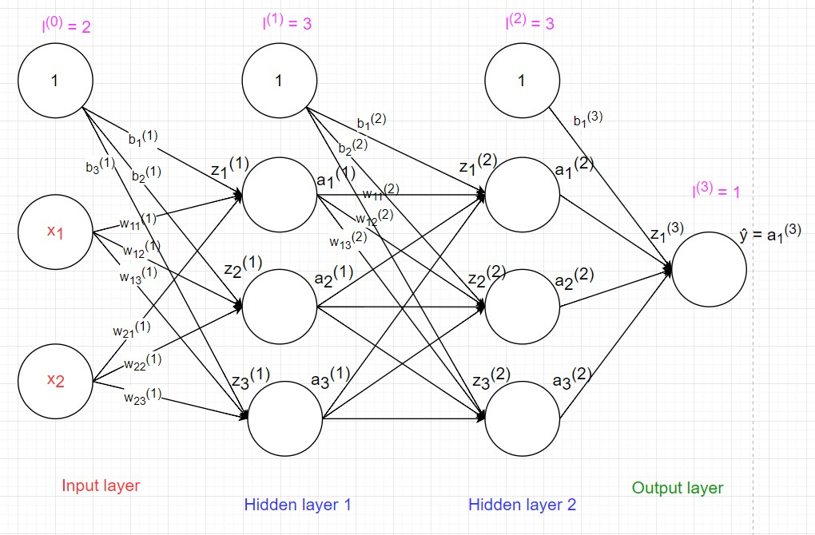
Notation

Slide 15
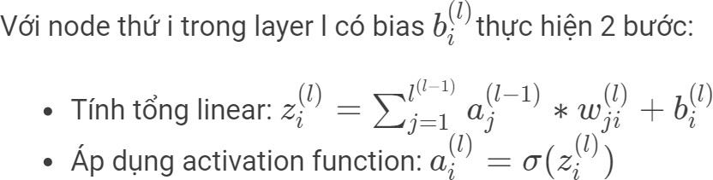
Feedforward

Slide 16
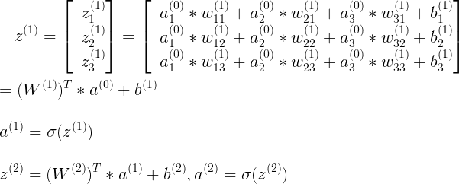
Feedforward

Slide 17
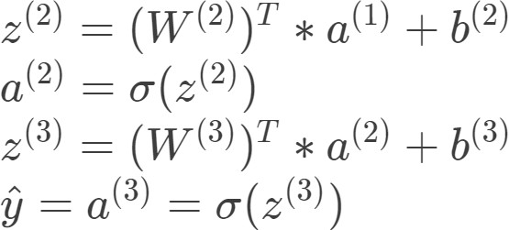
Feedforward

Slide 18
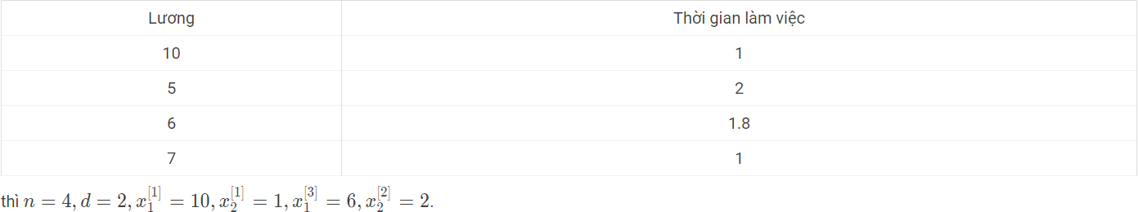
Dataset

Slide 19
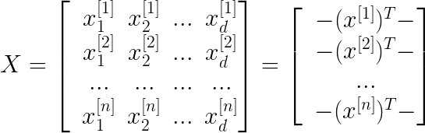
Matrix presentation

Slide 20
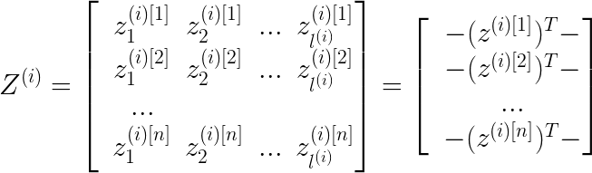
Matrix presentation

Slide 21
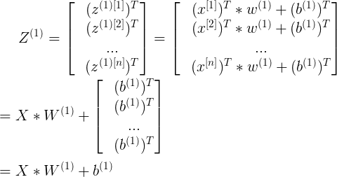
Matrix presentation

Slide 22
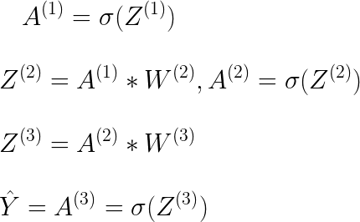
Matrix presentation

Slide 23
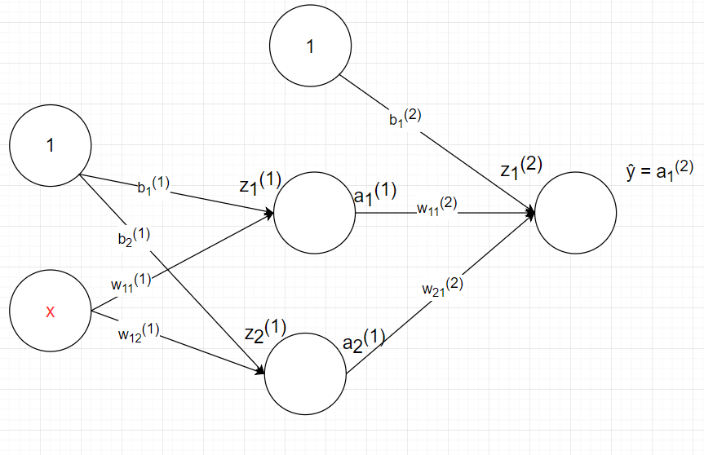
Why non-linear activation?
Suppose we use linear activation function, what is the output?

Slide 24
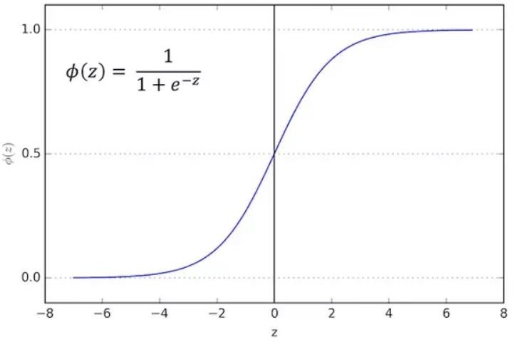
Sigmoid

Slide 25
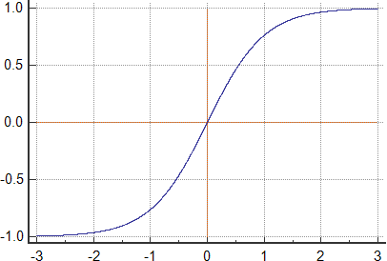
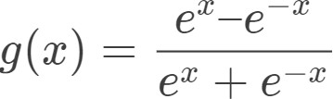
Tanh

Slide 26
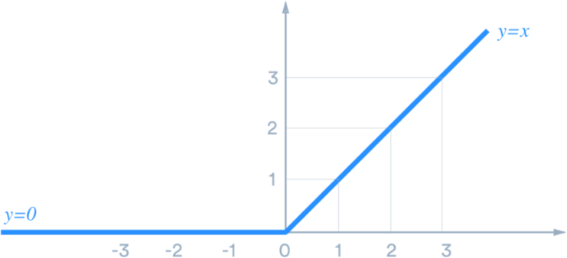
Relu
y = max(x, 0)

Slide 27
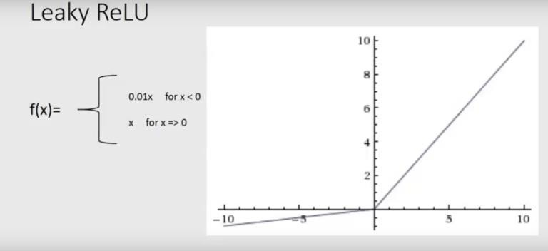
Leaky ReLU

Slide 28
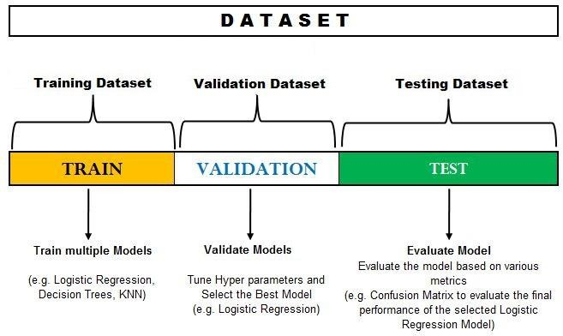
Training set/Validation set/Test set

Slide 29
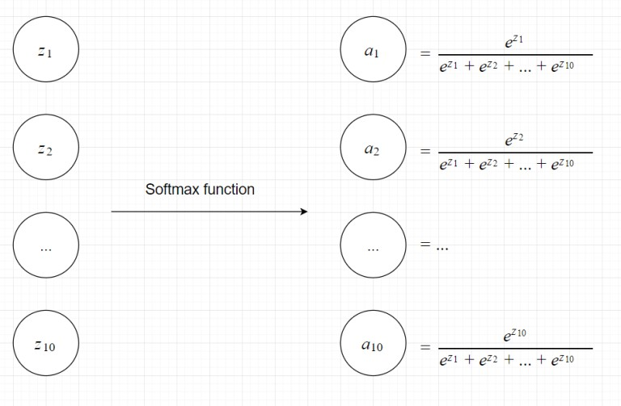
Softmax function

Slide 30
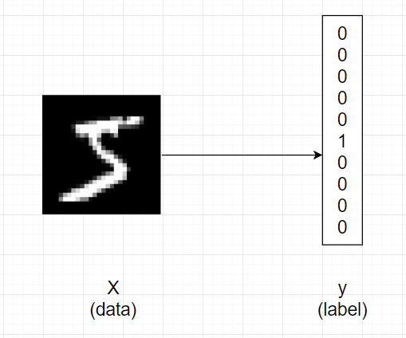
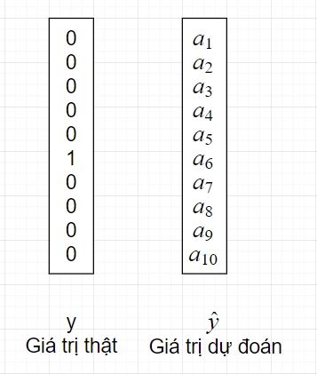
One-hot encoding

Slide 31

Cross-entropy loss
Similar to binary_crossentropy

Slide 32
Backpropagation

Slide 33

Q&A

Slide 34

The end

